Slide 1
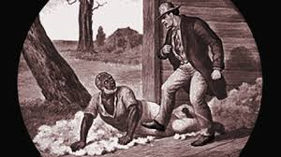
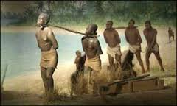
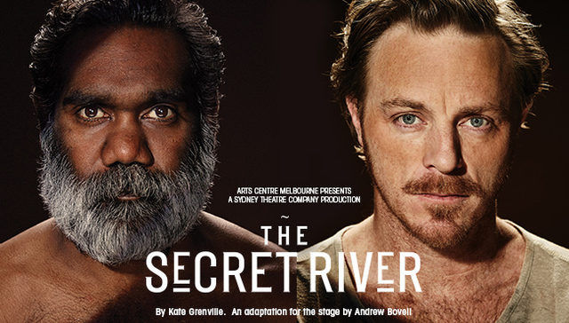
Post-Colonial Literature:
The Discourse of slavery

Slide 2
Lesson Aims and Objectives:
To explore post colonial texts
Investigate the themes each text raises and the relevance to contemporary society
Develop ways of taking the texts into the classroom to stimulate analysis of texts.

Slide 3
Introduction:
The colonisation of Australia: https://www.youtube.com/watch?v=oTJG8AJ_tDs
The Secret River
The Rabbits
No Sugar
The Drover’s Wife
DVD:
Still Images

Slide 4
Definition:
Post Colonial literature: is a body of literary writing that responds to the intellectual discourse of European colonization in Asia, Africa, Middle East, the Pacific and elsewhere

Slide 5
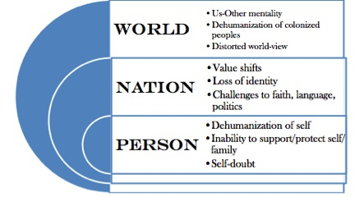
POST COLONIAL FICTION
Post-colonialism asks the reader to enter a text through the post-colonial lens. The chart below will help you see how to approach a post-colonial reading of a text. As a reader, you would look for the effects of colonialism and how they are addressed through the plot, setting, and characters' actions.
Theory
Eward Said's book 'Orientalism' (1978) is considered the foundational work on which post-colonial theory developed. Said, then, could be considered the 'father' of post-colonialism. His work, including 'Orientalism', focused on exploring and questioning the artificial boundaries, or the stereotypical boundaries, of the 'others.' This is the 'us'-'other' mentality that many colonizers take with them into a new country. Such simple generalizations lead to misconceptions and miscommunications, which are often the basis of post-colonial analysis.

Slide 6
The Secret River
Published in 2005, The Secret River is the first book in a trilogy by Kate Grenville that tackles the morally complex history of the colonization of Australia. The Secret River emerged out Grenville's research into her ancestor, Solomon Wiseman, who served as the model for William Thornhill. Solomon Wiseman was a lighterman on the Thames in London until he was arrested and deported to the convict colony at New South Wales for stealing valuable timber. Like William Thornhill, Soloman Wiseman built a thriving business in Australia and acquired great wealth. Drawing on the life of Soloman Wiseman and records of the conflicts between the settlers and the Aborigines, Grenville tells a sweeping story of a man determined to shed his past and build a new life for his family in the daunting landscape of New South Wales.
In The Secret River, Grenville explores the destructive clash of civilizations that occurred during the colonization of Australia. She tells a compelling story about the initial encounters between the Aborigines and the white settlers and the competing claims to the land that eventually lead to the violent dispersal of the Aborigines and the foundation of modern Australia. The Secret River is part of a new trend in Australian literature that explores the nation's controversial and often ignored convict past and marginalization of the Aborigines.
in Searching for the Secret River, Grenville recounts the creative process of taking historical facts and turning them into fiction. The book is part memoir, part research record, part creative writing manual. The book provides great insight into every aspect of the germination and writing of The Secret River.

Slide 7
THEMES
Clash of Civilizations
Aboriginal Culture
Alternative Path of Australian Development
Social Hierarchy
Self-Creation
The British Class System
Belonging
The Disorientation of the Immigrant

Slide 8
CLT
Post Colonialisation
Minority Groups

Slide 9
STYLE
Grenville adopts a traditional realist structure and framework of the narrative which is strictly chronological. The novel is broadly divided into three main sections: those that deal with the characters’ experiences in London, Sydney and Thornhill’s Point.
Grenville’s prose is designed to complement the historical setting with her characters adopting some phrases and words from the settings both in England and Australia. Instead of using quotation marks for dialogue, Grenville uses italics so that her characters speak within the text instead of traditional line breaks. Some of the terminology that Grenville uses was common to the era and often reminds the reader of the cultural background of the characters.
Grenville chooses not to use any Aboriginal languages in The Secret River
A significant distinguishing factor between the white settlers and the Indigenous Australians is not just in the lack of dialogue for the Aboriginals but their lack of names. William Thornhill is given his surname as his identity but the Indigenous Australians are named by their appearance “old grey beard” and “the younger one”. The difference in ways of naming highlights the ignorance of the English characters as well as allowing them to be detached from the characters that they are harming.
Dialogue conjures historic references and creates picturesque imaginary images of objects, characters and the landscape.

Slide 10
SETTING
One can determine that the setting for this novel is post-colonialism.
Natural:
Political:
Manufactured:
Intertextuality: Aboriginal Act where half caste children were taken away as part of the Stolen Generation

Slide 11
VALUES AND ATTITUDES
The Author: heirarchy, positions reader against genocide, knowledge, non stereotyping, attitude towards slavery, freedom, literary family, gender roles, first families, natural inhabitants
How does the author use narrative techniques to highlight the values and attitudes by both the author and the reader.

Slide 12
SYMBOLISM
The steeples in London, which looked down on everything in the city, represented God to Thornhill. It seemed to Thornhill that these steeples were always watching him.
The lions on the gateposts at Christ Church were a symbol of Thornhill’s mother and of his earliest memories. When Thornhill built his house in Australia he ordered lions to sit on the gateposts but they wound up looking less ferocious than the ones Thornhill remembered from Christ Church.
Thornhill won this Dogget’s Badge in a rowing competition. It symbolized that he was the strongest and best rower.
It was when Thornhill tried to steal this Brazil wood that he was caught and arrested for theft.
Darkness
Metaphors animals and insects, Aboriginal Carvings
The River
The title
Guns
Daisies
Scorched Earth

Slide 13
CHARACTERS
Protagonist:
Flat:
Round:
Antagonist
Contangonist
Guardian or Mentor
Stock
Who are these characters and how are they represented.

Slide 14
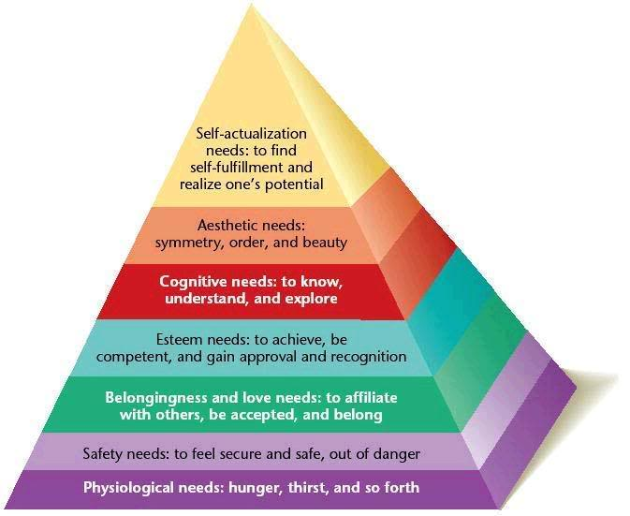
Maslow’s Hierarchy of Needs
Not original to Maslow

Slide 15
READING THEORY
Gaps and silences:
Foreground and privileging:
Dominant and resistant readings:

Slide 16
INTERTEXTUALITY OF GENRES
The Drover’s Wife
The Rabbits
No Sugar
Still Images

